Slide 1
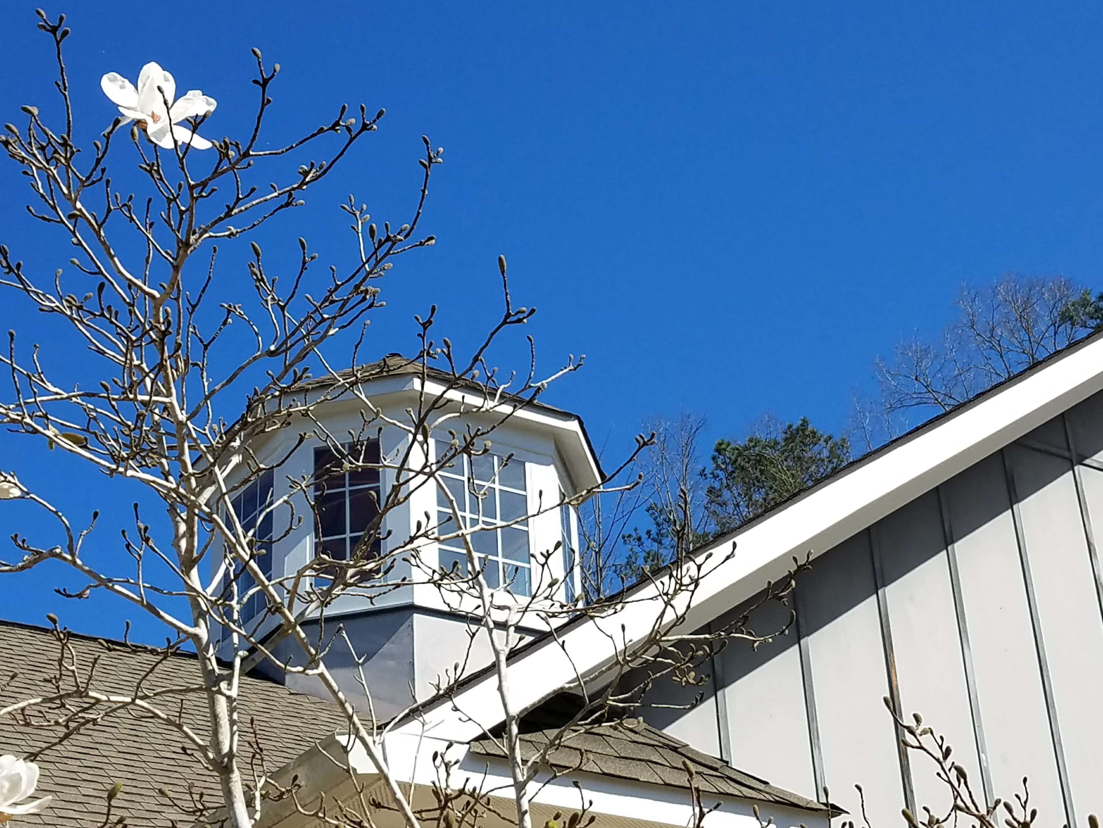

C HE R OKE E F A MIL Y VIOLE NC E C E NT E R
2 0 1 7 A N N U A L R E P O R T
H E L P , H O P E , H E A L

Slide 2



O U R V I S I O N
We envision a world where intimate partner violence is a distant memory and healthy relationships prosper.
O U R M I S S I O N
The Cherokee Family Violence Center enhances the safety of those impacted by intimate partner violence through services that empower victims while advocating for a community standard of zero tolerance for violence in the home.
O U R V A L U E S
We respect and honor our clients’ individual paths, and encourage them to use their strengths in attaining personal empowerment.
With a focus on personal safety and growth, the services we provide are innovative and forward-thinking.
We embrace diversity and provide culturally responsive services delivered with compassion and respect.
We foster a coordinated response by working closely with the community and encouraging volunteer involvement.
We are committed to high standards of honesty, absolute confidentiality and accountability for our actions and words.
We value the history and longevity of our organization and commit to our sustainability and growth through fiscally responsible policies and community education.
Because system change is integral to client safety, we work toward a global paradigm shift that assumes equality for all.

Slide 3
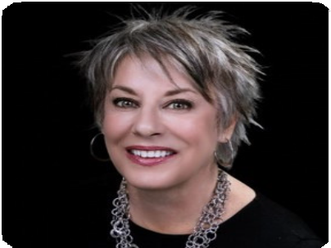
F R OM T HE E XE C UT IVE DIR E C T OR
Dear Friends and Supporters of CFVC,
In 2017, we accomplished many things. We secured more than $450,000 in new funding to enable CFVC to better deliver services in a more trauma-informed manner. We created a Community Office, where we can provide extended services to domestic violence victims who live in our community and outside of our housing program and our emergency shelter. We obtained funding for a 15-passenger van. Purchasing a vehicle of this size will help meet the transportation needs of the women and children in our programs. And, we started the groundwork to reinforce our infrastructure for our ever-growing Children and Teens Department by moving a seasoned staff member over to provide leadership and guidance to staff who provide services for our children.
Every year, we strive to improve the services we provide our clients and offer programs that enrich their lives and provide healing from the trauma they have been subjected to. As more children and teens are participating in our programs, we’ve realized CFVC is running out of room! In 2018 we hope to expand the activity area designated to our teens. We need to have enough space to provide extra services like drama, art therapy, and a computer lab.
We are grateful to all who continue to invest in CFVC’s mission of help, hope and healing. Our community partners, individual donors and grant sponsors allow us to make a difference in the lives of so many women and children each year. Thank you for your continued support.
Meg Rogers Executive Director
H E L P , H O P E , H E A L

Slide 4
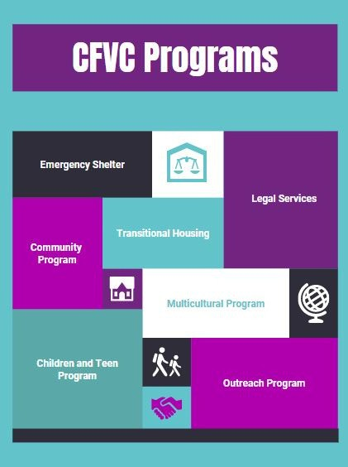
CFVC'S FREE SERVICES INCLUDE:
Safe and secure emergency shelter, crisis hotlines and in-person crisis counseling Support groups for adults and children Legal services, emergency protective orders and court accompaniment Linguistically competent services for immigrant victims of domestic violence provided with cultural humility
Income-based supportive housing and household establishment assistance Emergency financial assistance and public benefits assistance
Free emergency 911 cell phones and individualized safety planning Education programs on domestic violence, mindfullness, intimate partner violence, and financial literacy Advocacy with other agencies

Slide 5
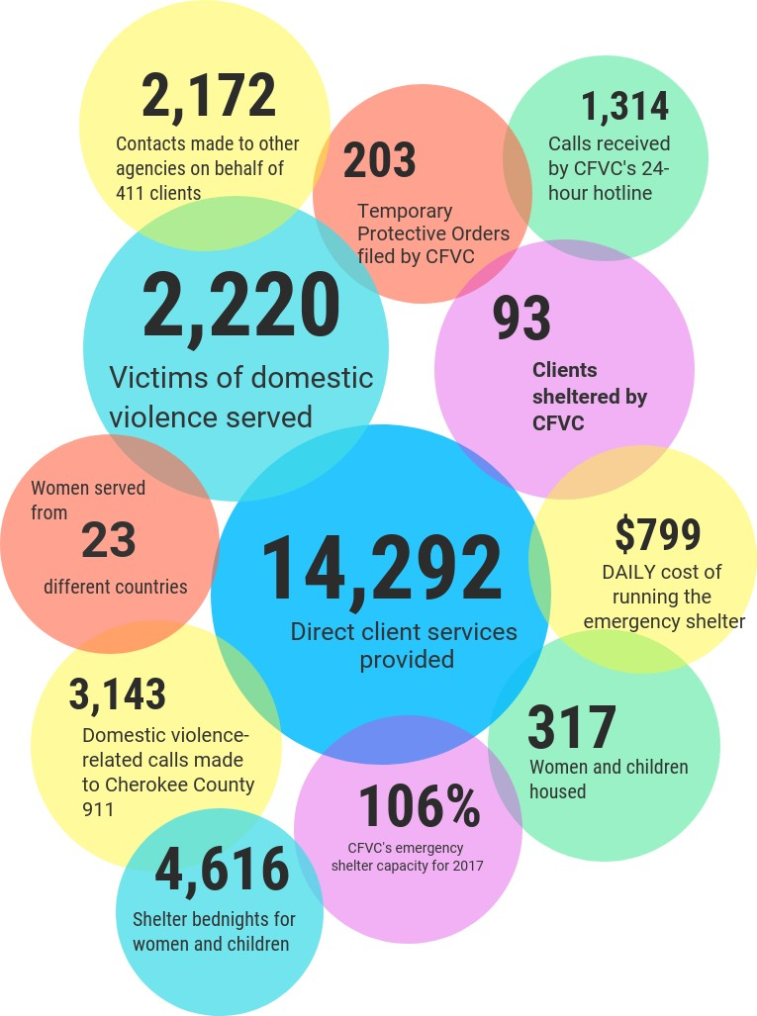
by the numbers
C F V C S T A T S
CFVC serves victims of domestic violence and their children. We have the largest transitional housing development in the nation. Our emergency shelter is the hub for the Statewide Spanish Hotline for domestic violence. And, we have a long history of helping under-served populations such as the immigrant victims of domestic violence.

Slide 6
Fundraising Exp.
1%
Admin. Exp.
6%
$93
out of every $100 that comes into CFVC goes directly to program services.
Program Exp.
93%
$1,450,000
$1.4 MM
$1,087,500
in revenue for 2017
$725,000
Other
5%
Fundraising
3%
Contributions
4%
Indirect Public
16%
$362,500
$0
2015
2016
2017
72%
of CFVC's revenue comes
from grant sources.
Grants
72%

Slide 7

"I've learned to overcome my fears."
~ Patricia, Multicultural Client
“I just want you to know the comfort I received from Lyndsey was incredible. She's the most helpful and understanding person."
~ Legal Services Client
"I couldn’t have imagined myself where I am now when I came in for services 3 years ago."
~ Grace, Transitional Housing Client
"Thanks to the Support Group, I am strong enough to keep going."
~Ana, Multicultural Client
H E L P , H O P E , H E A L

Slide 8


F UND E R S
Nearly three quarters of our work with victims is funded by grants. In 2017, CFVC received nine grants from local, state and federal organizations:
Cherokee County Community Development Block Grant (CDBG) Criminal Justice Coordinating Council
Judicial Council of Georgia/Administrative Office of the Court (AOC) Office on Violence Against Women
United Way
Violence Against Women Act (VAWA) Victims of Crime Act (VOCA)
H E L P , H O P E , H E A L

Slide 9

COMMUNITY SUPPORT
As a Non-Profit Organization, CFVC depends on the support of our community. The support of our community partners and individual donors allows our agency to bridge the gap between the funding we receive and the cost of providing services for the women and children in our programs. Our sincere gratitude is extended to the community partners and individual donors who contributed financially to our vision in 2017.
With thanks to our Patrons
(Contributions of $2000 and more)
His Hands Church Roach, Caudill & Gunn Anonymous
Ms. Molly Foundation Ryan D. Jones Christopher Davis Hamilton State Bank
Colonial Pipeline Company Todd Ping
Pamela and Milton Watkins Family Foundation Jenny Mummert
Bridgemill-Sixes Service League Wells Fargo
H E L P , H O P E , H E A L

Slide 10

Sponsors
Contributors
(Contributions up to $499.99)
Brian and Carmon Aaron Carolyn and James Alexander All About Towne, LLC Barbara and Warren Allen Tewnet Amakelew
Kathleen Amspacher Marvin Anderson Kathleen Baldwin Robin Ballew
Barry Bennett Mary Ann Best
George and Gemma Beylouny Pascal and Ebon Bourne Doree Bradbury
Bradshaw Farm NHA, Inc. c/o Team Management LLC Catherine Bryans
Kirk Buchholz Kathy Burton Amanda Butler Ernesto Cantu Kwok Cheung Philip Collins
Keith and Rebecca Costco Cox Automotive
Leslie Cushard
Amy and Steve Davidson Bradley Davis
William Davis Alice Desantis Inge Dibella Hope Doornbos Phylis Douglas Judy Douglas Tammy Driver
(Contributions of $500-$1999.99)
1Source International, LLC Sherry Able
Trevor Armstrong Lewis Ayers
Tracy Batten Dianne Berent Elizabeth Bradford Michael Bryson Steven Cook Darden Petroleum Hector Diaz
June and David Farmer
First United Methodist Church Michelle Gettens
Aisha Renee Ghafoor-Harris Wesley Gibson
Graceful Tables Val Harlow Brian Haurylak
Brittania Herbold Cheryl Hill
Dr. and Mrs. Eugene Hill Teresa Holloway Kandice James
Janet Johnson Tracy Keyser Bhrett Kistler Betty Kline
Lee Lusk Stephen Metzger Michael Mimbs
MOMs Club of Acworth East Dennis and Debra Murphy Robert Nardelli
Northside Hospital - Cherokee Lonnie Peplau
Joshua Pinkston John Putnam Quantum Radiology Raydeo Enterprises Mark Seymour Kimberly Spears
Southeast Restoration
St. Clements Episcopal Church Tim and Mary Lou Sutton Clifford Switzer
Major Warner Wells Fargo Caroline Wilkinson
Women of Woodstock
Woodstock United Methodist Church Janice Yohan
Rick and Holly Ziegler
H E L P , H O P E , H E A L

Slide 11
Contributors (Cont.)
Julie Dunn Laura Elledge Sandra Erreger Elaine Eternod June Farmer
Mary Fischer-Mullins Diane Ford
Natalie Fowler Randell Fox Arlene Freeland Elizabeth Frisbee
David and Deborah Frost Teresa Garay
Anita Geoghagan
Georgia Pride Remodeling The Georgiou Family Filomena Girnys
Graphic Packaging Ruth Graveline Melvena Grines Michael Hagain
David and Megan Hale Mary Hardy
David Haskett Linda Hawkins Margie Hendrix Holly Hesse Daniel Hesse Donna Hew
The Home Depot
John and Susan Isakson Janet M. Jackson
Matt and Emily Jobe
Gail Jorgenson Jonathan Joseph Careese Kelly Coley King
Tim Kinnersley Theresa Kriz-Dussia Anthony Lamanac Rebecca Lane Belinda Leach
Niki Lemeshka
Jennifer and William Letsinger Jamie Low
Mark Lukehart Cleary Mahaffey P Luann Mahan
MARTA - ATU Local 732
Kay Martin Julie Maxwell
Susanne McCardle David McDonald Tracy McGrath Rodney McKee Sherie McNeal Susan Messersmith Cynthia Mial
Ronald and Margaret Mixon Cheri Moreno
Todd and Dale Morrissey Lori Moser
Ashley Murchison
M. Neese Melissa Nichols April Odom
Diane Offutt
Ostheimer Concrete Paving, LLC Kenneth Owen
Maryann Page Bryan Palmeri Edward Parker
Mary Elizabeth Parker
L. Jay Patouillet Cheris Pearson Sandra Pederson Robert Peffen John Phillips Shawn Poole David Rathel Laura Rodriguez Benjamin Roth
Kathleen and Stephen Sawyer Ashleigh Scaglotti
Candace Schilling
Service League of Cherokee County Robert and Vicki Sheldon Katherine and Richard Shirley Monique Simmons
Jean and CraigSkogen Debra Smith
Tracy and Doug Stapleton Rosalie Stein
Kyle and Gina Surratt The TC Show
Sherri Teem Cher Terry Arely Tovar Martha Trout
Alinda Tryall Lyn Turnell
Cyndi Varneybray Charity Vincent
Waleska United Methodist Church Mark Webb
Christine and Ronald Whittle Barbara Wilke
Allison Williams Merry Willis
Robert and Pamela Wolfe
Women of the Moose, Canton Chapter 972 Woodstock Outlet
Contessa Wright Courtney Wynn Caroline Zipkin
H E L P , H O P E , H E A L

Slide 12


2018 G OA L S
CHILDREN'S CENTER
We hope to provide a dedicated area for our children, providing both support and enrichment activities for them, including expanding therapeutic services to include the arts.
SHELTER EXPANSION
To fully support the emergency housing needs in our community, we will
explore expanding our emergency shelter.
The need for emergency shelter in our community has grown far larger than what our 12-bed facility can accomodate. Last year it ran at 106% capacity.
TEEN CENTER
We want to create an activity space just for our teens. This space will allow us to provide teen-specific support and activities that will help break the cycle of violence.

Slide 13




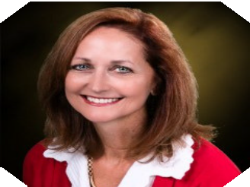





B OA R D OF DIR E C T OR S
The Cherokee Family Violence Center’s Board of Directors is responsible for raising funds for the agency, providing guidance for the agency and advocating for the agency and its cause in the community.
Debra Murphy, Board Chair Sherie McNeal, Vice Chair Abby Roach, Secretary Shawn Poole, Treasurer Ellia Simon
Cindy Murphy George Hutcherson Linda Breeden Michelle Frost
Pam Phillps
Debra Murphy, CFVC Board Chair
H E L P , H O P E , H E A L

Slide 14



P.O. Box 489 Canton, GA 30169
770-479-1804
Donate Online: www.cfvc.org
T H A N K Y O U
H E L P , H O P E , H E A L
W W W . C F V C . O R G

