Slide 1

2018 ANNUAL REPORT
CHEROKEE FAMILY VIOLENCE CENTER
draft - 2.2019

Slide 2
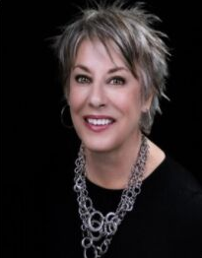
Dear Friends and Supporters of CFVC,
Since providing our first services in 1986, we have prided ourselves in offering programs and services considered best in practice as well as those that are the most beneficial to our clients. 2018 was full of progress with our programming. Last year, we began revamping our Transitional Supportive Housing Program to provide additional services that parallel industry best practices and will better equip our residents on their journey to self-sufficiency. We also collaborated with United Way to create a Community Connector Program. This program will become a connection to CFVC for domestic violence survivors in the surrounding counties so they can access resources and benefits we provide.
Change is evident in our Emergency Shelter and in our Main office. The Emergency Shelter’s renovations that took place over the summer afforded us the opportunity to add an extra bed. Now at 13 beds, our shelter is able to accommodate more domestic violence victims every year! Brand new appliances in the kitchen, a wall of washers and dryers, beautiful furniture, and a fresh coat of paint rounded out the updates in our shelter.
The Housing and Administration halls received a trauma-informed makeover, making the areas more comfortable for our clients and staff. We even transformed a restroom into a computer lab! Apartment residents now have computer access any time the Main Office is open to apply for jobs, complete schoolwork, and pay their bills.
We are so grateful to all who continue to invest in CFVC’s mission of help, hope and healing. Our community partners, individual donors and grant sponsors allow us to be the light in a world full of darkness, and make a difference in the lives of so
many women and children each year. Thank you for your continued support.
Meg Rogers, Executive Director
FROM THE EXECUTIVE DIRECTOR
HELP, HOPE, HEAL

Slide 3

OUR VISION
We envision a world where intimate partner violence is a distant memory and healthy relationships prosper.
OUR MISSION
The Cherokee Family Violence Center enhances the safety of those impacted by intimate partner violence through services that empower victims while advocating for a community standard of zero tolerance for violence in the home.
HELP, HOPE, HEAL

Slide 4

OUR VALUES
We respect and honor our clients’ individual paths, and encourage them to use their strengths in attaining personal empowerment.
With a focus on personal safety and growth, the services we provide are innovative and forward-thinking.
We embrace diversity and provide culturally responsive services delivered with compassion and respect.
We foster a coordinated response by working closely with the community and encouraging volunteer involvement.
We are committed to high standards of honesty, absolute confidentiality and accountability for our actions and words.
We value the history and longevity of our organization and commit to our sustainability and growth through fiscally responsible policies and community education.
Because system change is integral to client safety, we work toward a global paradigm shift that assumes equality for all.
HELP, HOPE, HEAL

Slide 5

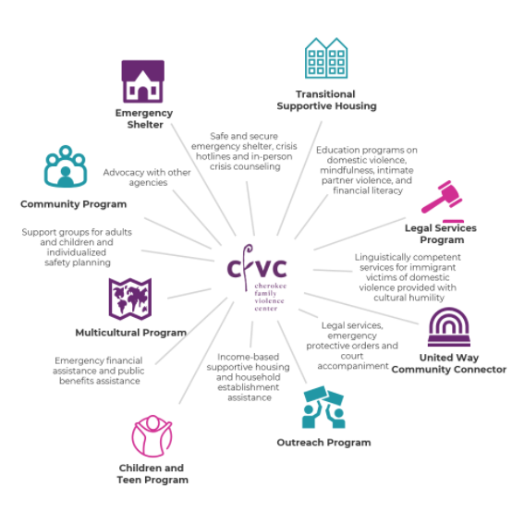
OUR PROGRAMS AND SERVICES
HELP, HOPE, HEAL

Slide 6

OUR FUNDERS
Nearly three quarters of our work with victims is funded by grants. In 2018, CFVC received seven grants from local, state and federal organizations:
Cherokee County Community Development Block Grant (CDBG)
Criminal Justice Coordinating Council
Judicial Council of Georgia/Administrative Office of the Court (AOC)
Office on Violence Against Women
United Way
Violence Against Women Act (VAWA)
Victims of Crime Act (VOCA)
HELP, HOPE, HEAL

Slide 7

Meg Rogers - speaking at the United Way's Best Practices to Address Domestic Violence Panel Discussion
No entity can fix this on its own. This [domestic violence] is a social justice issue. Our church community needs to be at the table, corporate community, mental health, schools. If we're going to agree domestic violence is unacceptable, we need to all be at the table.

Slide 8
Admin. Exp.
5%
Fundraising Exp.
1%
$94
out of every $100 that comes into CFVC goes directly to program services.
Program Exp.
94%
2018 Expenses
$2,000,000
$1.83 MM
$1,500,000
in revenue for 2018
$1,000,000
Contributions
3%
$500,000
Indirect Public
17%
$0
2015
2016
2017
2018
Grants
73%
73%
Fundraising
2%
Other
5%
0
25
50
75
of CFVC's revenue comes from grant sources.
Revenue Sources 2018

Slide 9
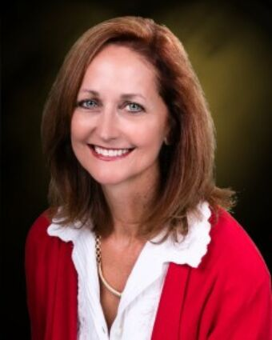
Add Board Whys
Debra Murphy, Board Chair
Jennifer Dunn, Vice Chair
Cindy Murphy, Secretary
Ellia Simon, Treasurer
George Hutcherson
Linda Breeden
Michelle Frost
Debra Murphy, CFVC Board Chair
BOARD OF DIRECTORS
The Cherokee Family Violence Center’s Board of Directors is responsible for raising funds for the agency, providing guidance for the agency and advocating for the agency and its cause in the community.
HELP, HOPE, HEAL

Slide 10
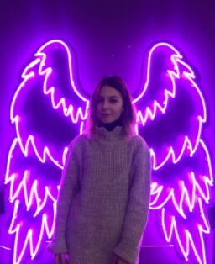

WHAT IS OUR "WHY"
Success Story
"Add asuccess story montage

Slide 11
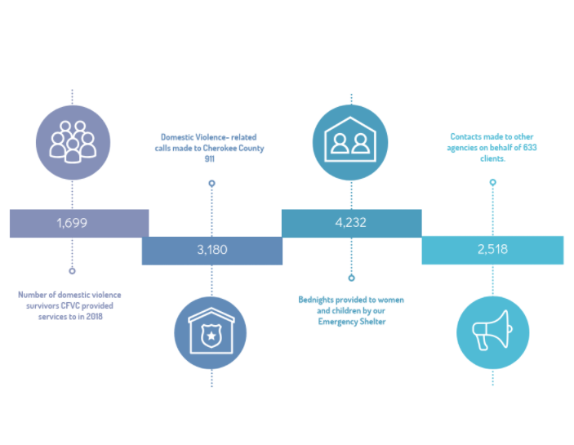
CFVC serves victims of domestic violence and their children. We have the largest transitional housing development in the nation.
HELP, HOPE, HEAL

Slide 12
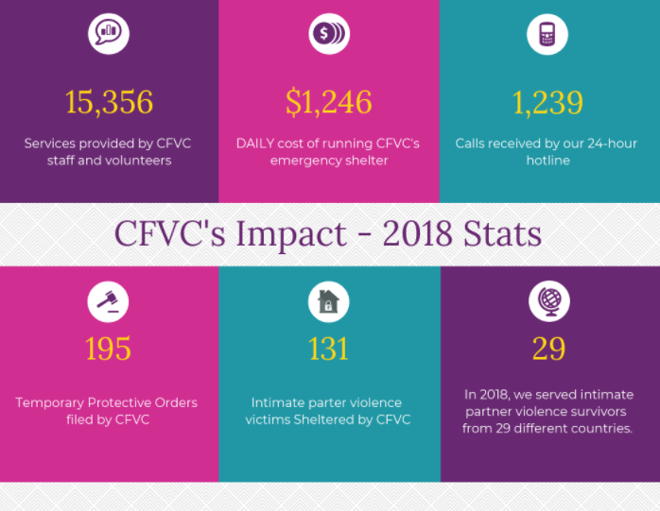
HELP, HOPE, HEAL

Slide 13
Our emergency shelter is the hub for the Statewide Spanish Hotline for domestic violence. And, we have a long history of helping under-served populations such as the immigrant victims of domestic violence.
Add updated infographic
HELP, HOPE, HEAL

Slide 14
Awards and Recognitions
Add awards and recognitions here

Slide 15



OUR GOALS FOR 2019
Goal 1
Goal 2
Goal 3
DV COurt?
????
?????
HELP, HOPE, HEAL

Slide 16
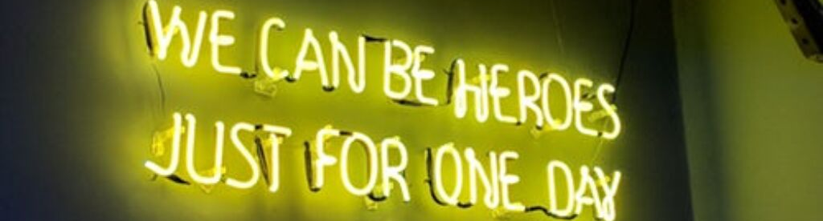

COMMUNITY SUPPORT
With thanks to our Patrons
As a Non-Profit Organization, CFVC depends on the support of our community. The support of our community partners and individual donors allows our agency to bridge the gap between the funding we receive and the cost of providing services for the women and children in our programs. Our sincere gratitude is extended to the community partners and individual donors who contributed financially to our vision in 2018.
(Contributions of $2000 and more)
His Hands Church
Woodstock Junior Women's Club
Mrs. Cindy and Dr. Tom Murphy
Ms. Molly Foundation
Roach Caudill and Gunn, LLP
Pamela and Milton Watkins Family Foundation
HELP, HOPE, HEAL

Slide 17


Sponsors
(Contributions of $500-$1999.99)
Aisha Renee Ghafoor-Harris
Ann D. King
Austin A. Watson
Boyd, Collar, Nolen & Tuggle
Bridgemill-Sixes Service League
Brown Specialty Travel
Chance New
Cynthia Wright
Debra Murphy
Edward Jones
First United Methodist Church
Gloria A. Avillar
Janet B Johnson
Kandice M. James
Kings Enterprise
Law Offices of Walter J. Lutes
Lisa Bouldin
Meg Rogers
Marianne Knudsen
Michael Mimbs
Northside Hospital Cherokee
Prestige Medical Group
Quay Financial Group
R and R Hospitality
Raydeo Enterprises, Inc.
Robert Nardelli
Rocio Brandau
Scott A. Hartsell
St. Clement's Episcopal Church
Stephen Jacobs
Teresa June Holloway
The Bagby Agency, Inc.
The Bray Agency
The Wheeler House
Theresa L. Andrews
Trevor D. Armstrong
Waleska United Methodist Church
Wingsology
HELP, HOPE, HEAL

Slide 18
Contributors
(Contributions up to $499.99)
Linda Breeden
Linda Emore
Lori Beth Kuczmanski
Lyn Turnell
Maarten Bok
Margie G. Hendrix
Martha A. Trout
Marvin E. Anderson
Mary J. Hardy
Mary Katherine Smith
MaryAnn Best
Matt Jobe
Megan L. Holcombe
Melinda K. Roulier
Merry A. Willis
Michael B. Hagan
Mike G. Truax
Morgan Larsson
Nanci Lamborn
Nancy Ross
Natalie B. Fowler
Nicole M. Morris
P. Luann Mahan
Phillip Jones
Phyllis Flowers
Queen Custom Couture, LLC
Rick Roberts
Robin Ballew
Ron Stephens
Russell H. Williams
Sandra Bowman
Service League of Cherokee County
Southernite Interiors
Stephen W. Hale
Summers Foundation, Inc.
Sunny Youn
Susanne H. McCardle
Teresa Wells
Terri Zahorodny
Tim Kinnersley
Tuyet Hurst
Women of the Moose
Woodstock United Methodist Church
Aisha Renee Ghafoor-Harris
AnnAlexia Scruggs
Amanda Locke
Angela Chambers
Anthony Baker
April H. Odom
Arlene F. Freeland
Ashleigh Frankle
Atlanta Plays It Forward
Barbara Amico Sheredy
Barbara Dorn
Barbara Wilkie
Barry B. Noll
Beasley Poole, LLC
Belinda K. Leach
Benjamin Roth
Betty Kline
Bobby A. Quinn
Brenda Holmes
Brown Specialty Travel
Caroline G. Zipkin
Catherine Kilminster
Christy Davis
Cindy Huffiness
Dana Garrett
Dean Larson
Deborah Loizzo
Debra Smith
Dekalb School Employees Foundation, Inc.
Deloris P. Ware
Diane Kelley
Doree M. Bradbury
Edward Jones
Eileen C. O'Connor
Ellia Simon
Emily Jobe
Eric Johnson
Fran Winkeljohn
Frederic Downer
Garner Crowder
George Hutcherson
Gertrude Brandau
Harry Johnston
Heidi Martin
Hope Doornbos
James Ronnie Brown
Jamie Low
Janet M. Jackson
Jennifer Dunn
Joseph L. Baker
Joshua H. Kirkland
Joshua Pinkston
Josselin T. Martin
Judiann Dohallow
Julie C. Fowler
Jyl Craven
Karl Reder
Kathleen Amspacher
Kathleen Atkins
Kathleen Thompson
Kathy Rufo
Kay J. Martin
Kaye Power
Kenneth L. Owen
Laine K. Wood
Laura Bailey
HELP, HOPE, HEAL

Slide 19


THANK YOU
Mailing address
P.O. Box 489, Canton, GA 30169
Donate Online
www.cfvc.org

